Slide 1
Pulse PT
Rafael Montes
Parth Desai
Sam Bohr
Andrew Alhaj
Daniel Christenson
Julian Ajja

Slide 2
Risks and Challenges
Learning Windows Server 2019
Working in the
Backend
Implementation of Redux
Minor bug issues
Styling
Rafael
Sam
Andrew
Daniel
Julian

Slide 3
Sprint 6 Work
Hosted on Google Cloud
Windows Server 2019
Final documentation worked on

Slide 4
Styling Updates
As a trainer, I would like better look and feel such that pages are easier to use and navigate.
Utilizing HTML components to edit page layout
Improvements to aesthetics using CSS

Slide 5
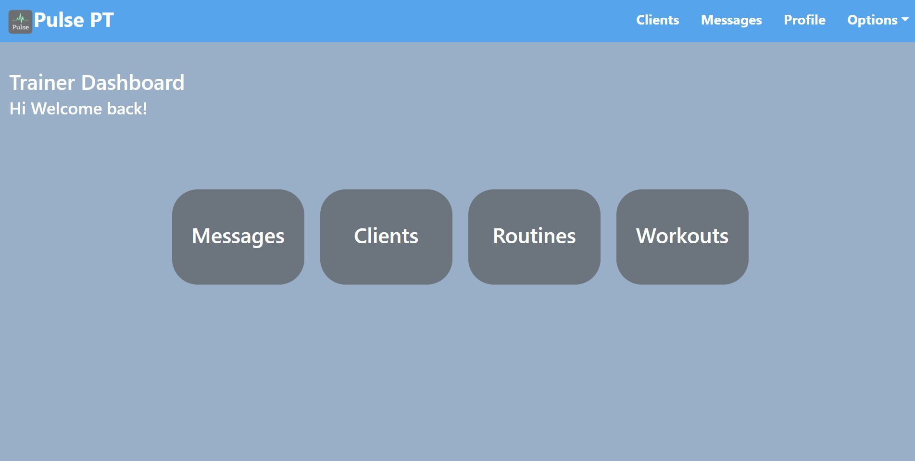
Styling Updates

Slide 6
Workout Creation Update
As a trainer, I would like a list of muscle groups to select from to make workouts easier to create.
Generated a list of muscle groups for trainers to choose from
Implemented this feature using reactstrap into a searchable select tab for ease of selection.

Slide 7
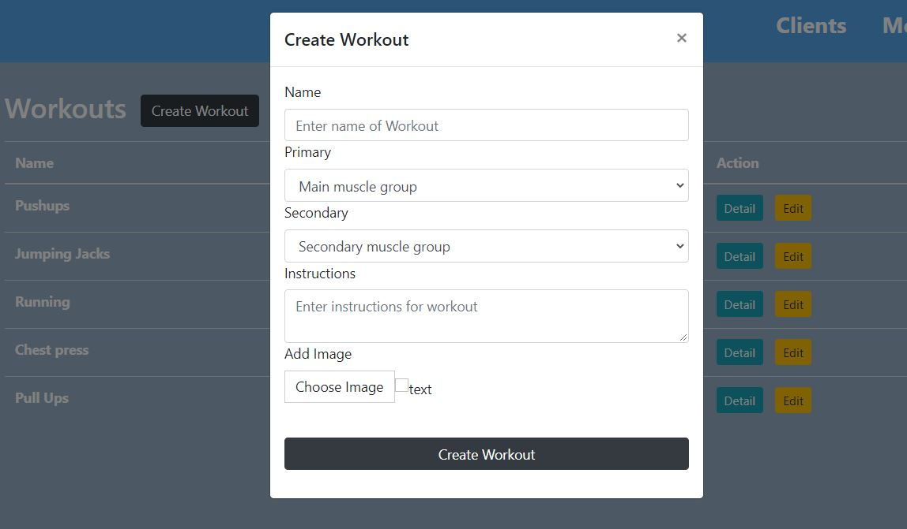
Workout Creation

Slide 8
Next Sprint Objectives
As a trainer, I would like cleaner looking pages that are easier to use and navigate.
This will be done by continuing to evolve the styling of pages with CSS to better align with our Wireframes.

Slide 9
Mobile Profile Workoutlist
As a subscriber, I would like to search for a list of available workouts and routines.

Slide 10
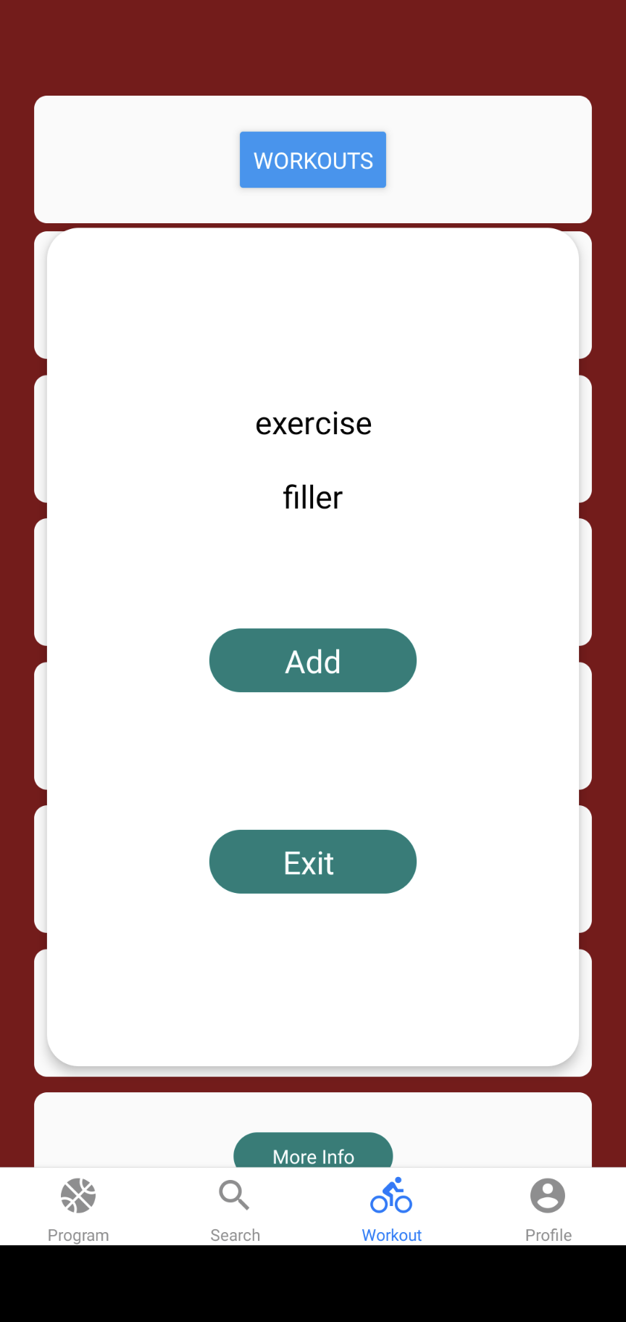
Mobile Profile Workout list

Slide 11
User Stories for next Sprint
As a subscriber, I would like to search for a list of available workouts and routines.

Slide 12


Workout Picture
User Story: As a trainer, I would like to be able to add images to my workouts to show how they are done
Research
Implement code from last sprint
Use redux and props to display
Test

Slide 13
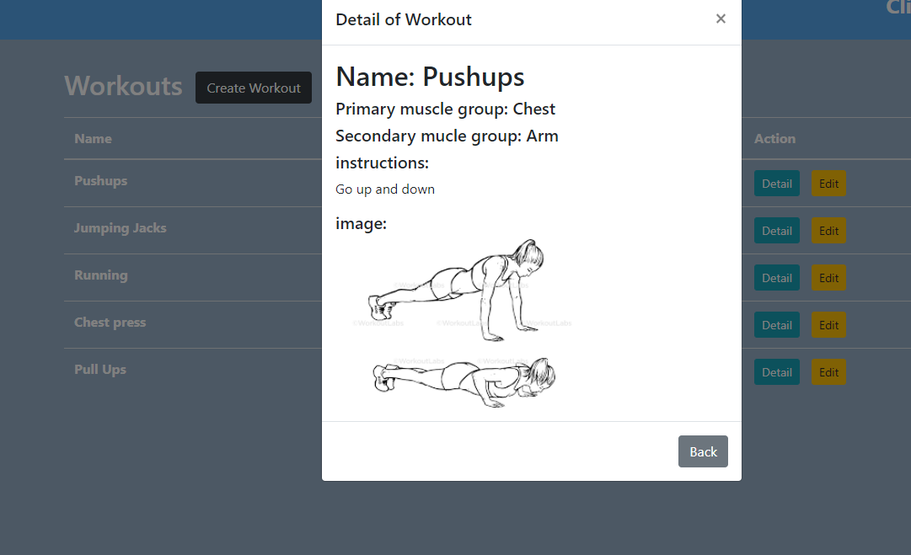
Workout Picture

Slide 14


Profile Information
User Story: As a trainer, I would like to be able to input my profile information
Research
Create Form using reactstrap
Add Schema to database
Add axios route to backend
Make API call in frontend
test

Slide 15
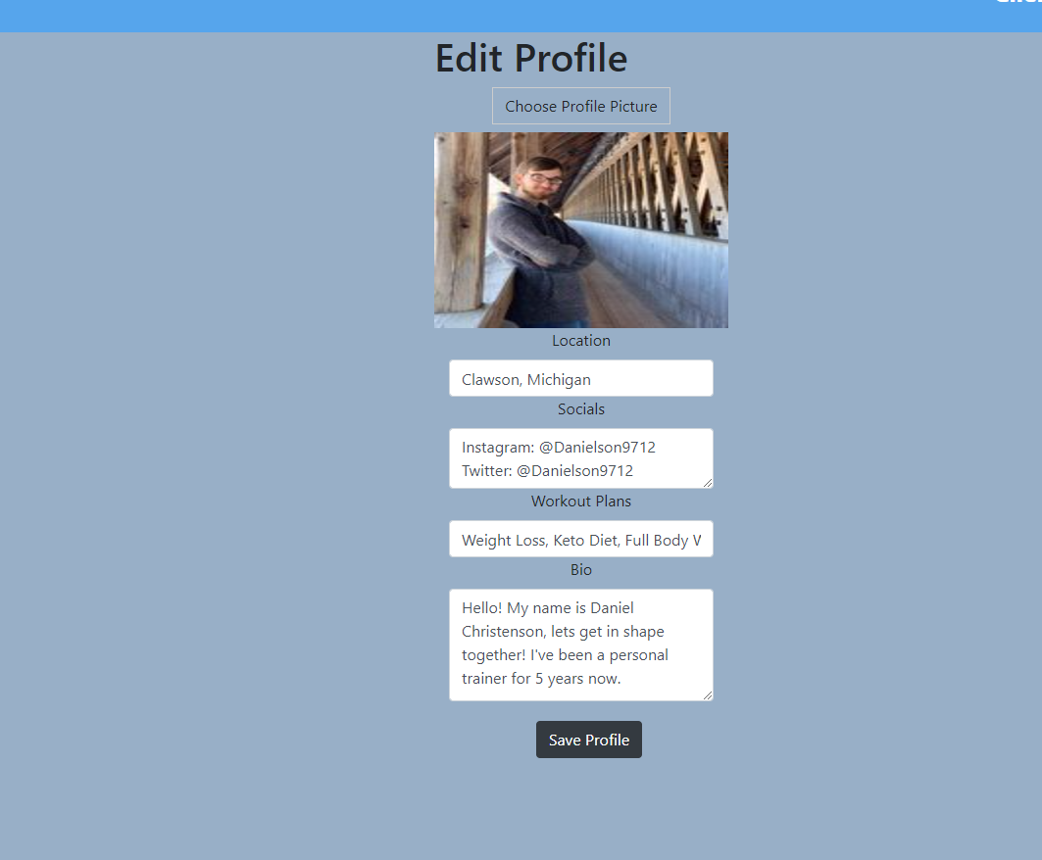
Profile Information

Slide 16
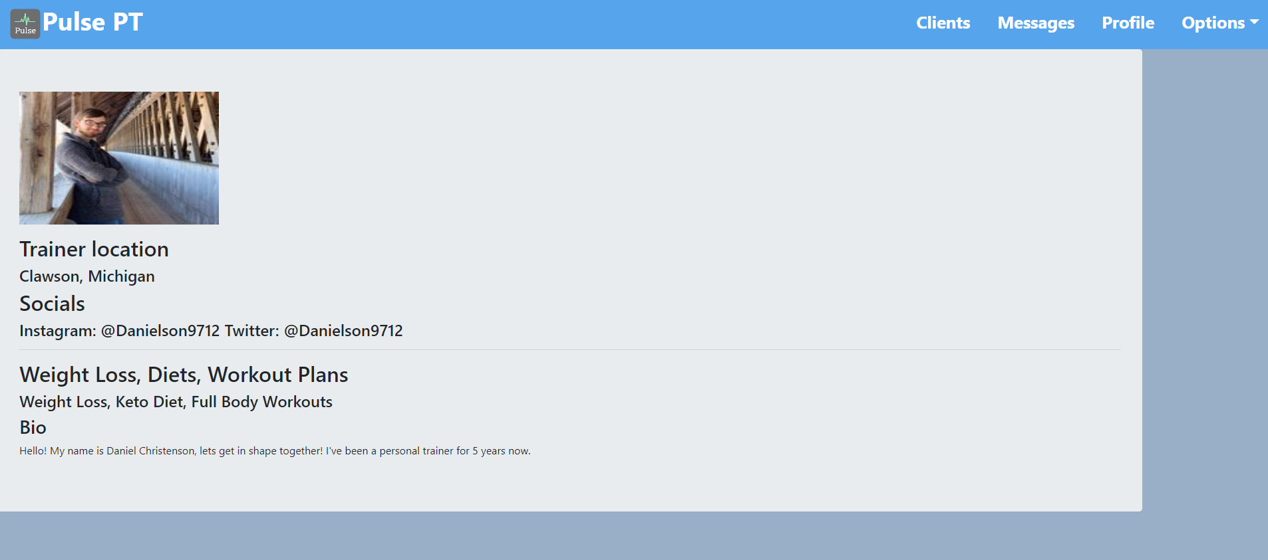
Profile Information
User Story: As a trainer, I would like to be able to view my profile information
Research
Make axios call from backend
Display on profile page

Slide 17
Next Objectives
Add a forgot password option
Help out with CSS and documentation

Slide 18
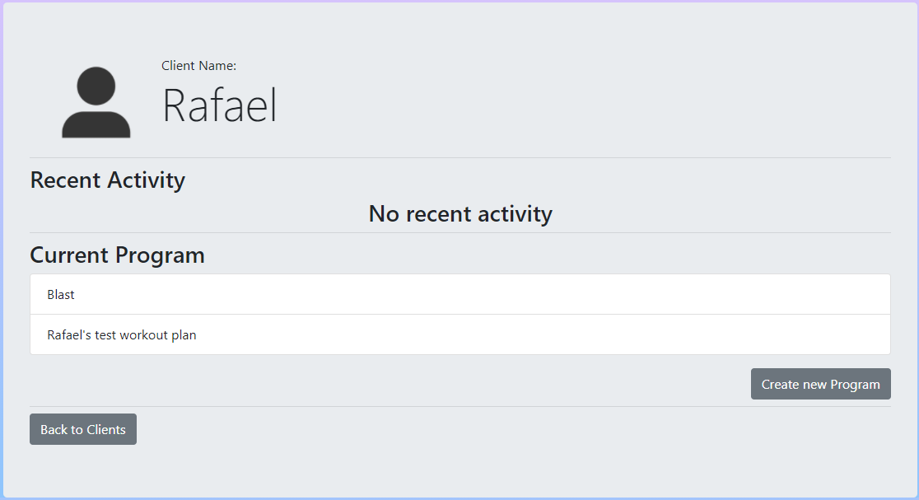
Client Page
User Story:
As a trainer, I would like to be able to view a details page of all of my clients.
As a trainer, I would like the ability to create programs for my clients
Able to view a details page of all your clients.
Able to create a program for clients

Slide 19
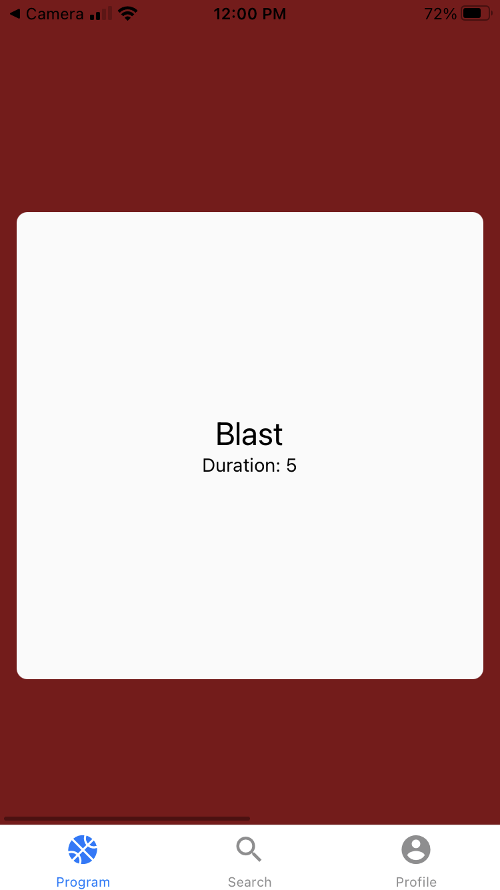
Program Tab
User Story: As a subscriber, I would like to see the program that was given to me by my trainer
Able to display the routines of the program
Work in progress
Next implement workout session logic

Slide 20
Next Objectives
Finish workout session logic
Fitbit integration
Styling program tab

Slide 21
Mobile This Sprint
Subscriber
I would like to be able to a see a trainers information
I would like to be able to subscribe to a Trainer
I would like to upload a picture to my subscriber profile and be able to change it
I would like a new style to the app

Slide 22
Mobile Next Sprint
Subscriber
I would like to see my past weights displayed on my profile in a graph to my progress over time
I would like nice transitions from the pages, for the popups and for the tabs so the app looks cleaner and feels more responsive
Add Splash screen to the beginning of the app

Slide 23
Demo

Slide 24
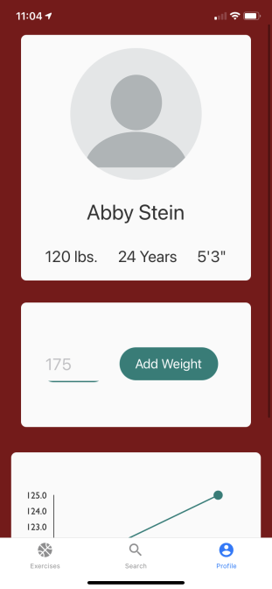

Slide 25
THANKS

